Slide 1
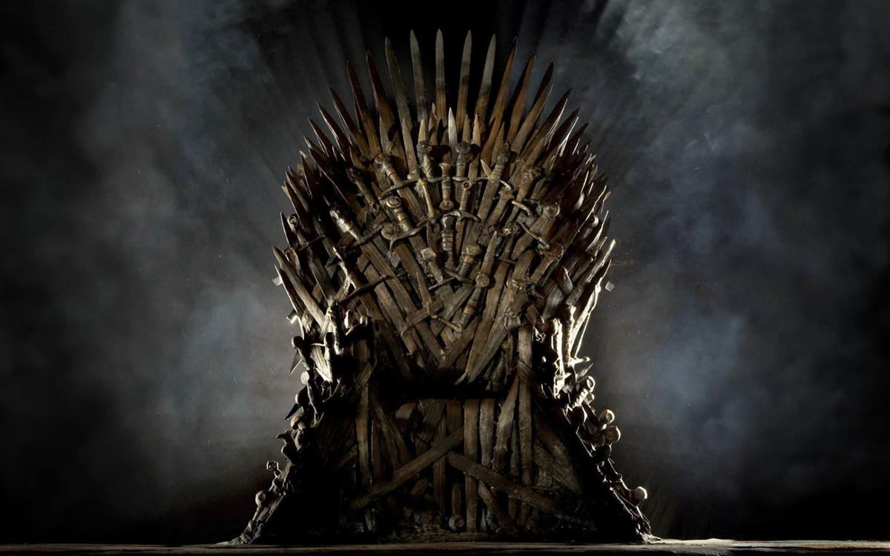
Exploratory Data Analysis of A Game of Thrones Character Deaths
Samantha Beard DSC 530 Final Project

Slide 2
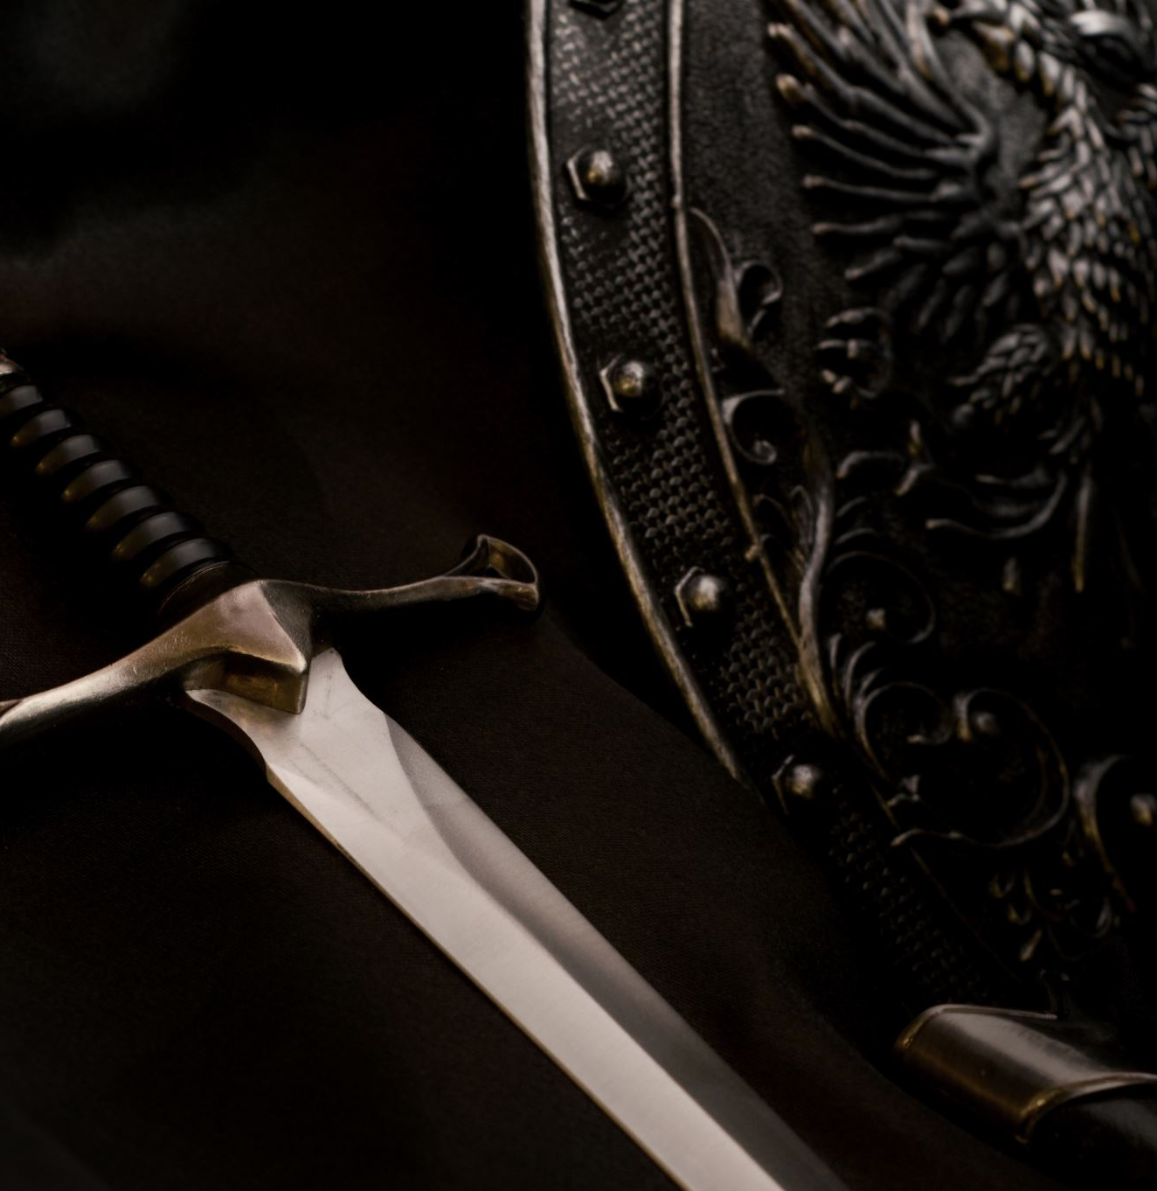
Scenario:
If you’ve seen the show or read the books, you know that there are thousands of deaths throughout the series of A Game of Thrones, and that the series is full of magic. However, what if magical methods/weapons were removed from the data? This would include dragons and White Walkers, as well as weapons that could not be forged without magic, such as ice swords.
Who would be the most vicious killer in all of Westeros?
How many deaths would have still happened?
What is the most used weapon?

Slide 3

Hypotheses:
Daenerys will lose the largest number of deaths associated with her name.
Cersei will have the most deaths on her hands.
Sword will be the most used weapon
House of Lannister will have been responsible for more deaths than House of Stark and House of Targaryen

Slide 4
What data will be considered?
Name – person who died
Allegiance – who the person that died is aligned with
Season – season the death took place
Episode – episode number in the season
Killer – who is held responsible for the death
Killers House – who is the killer aligned with
Location – where did the death take place
Method – weapon used
Magical – True or False

Slide 5
These key words for the method of death will indicate if the death was magical.
Dragon
Demon
Ice
Magic
Moon
White Walker

Slide 6
1149
non-magical
1075
magical

Slide 7

When Deaths Occur
Some of the more interesting data trends were regarding the statistics of this dataset have to do with when deaths occur across the series and across seasons.

Slide 8
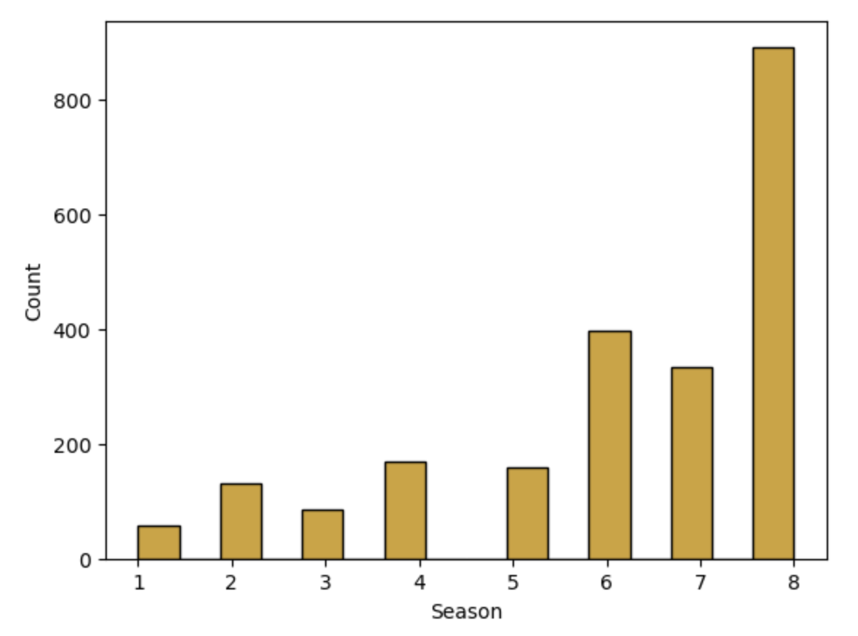
All Deaths Over the Series
All Deaths Over Series
Looking at the data of all deaths, there is an upward trend as the series goes on.

Slide 9
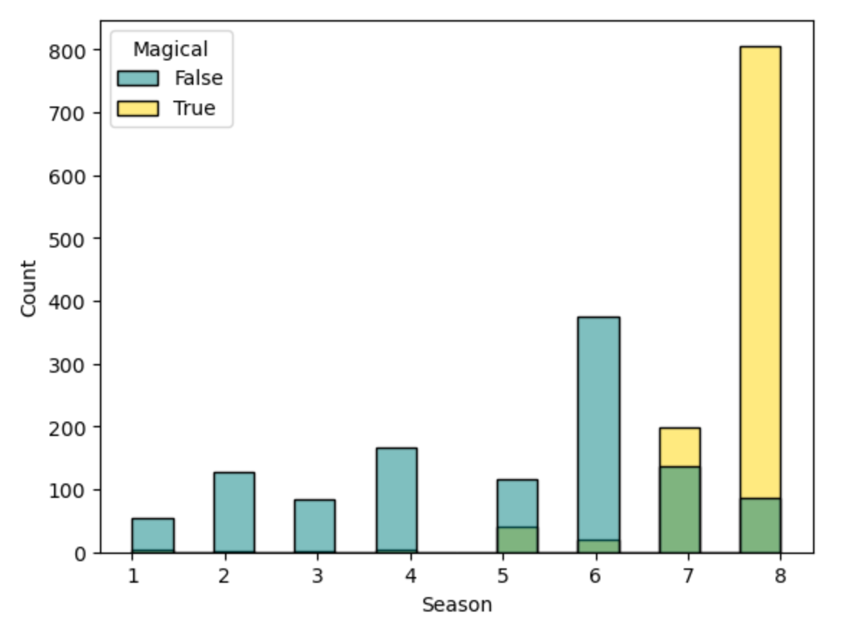
However, when we look at magical versus non-magical deaths across the series, magical deaths are almost exclusively in seasons 7 and 8.

Slide 10
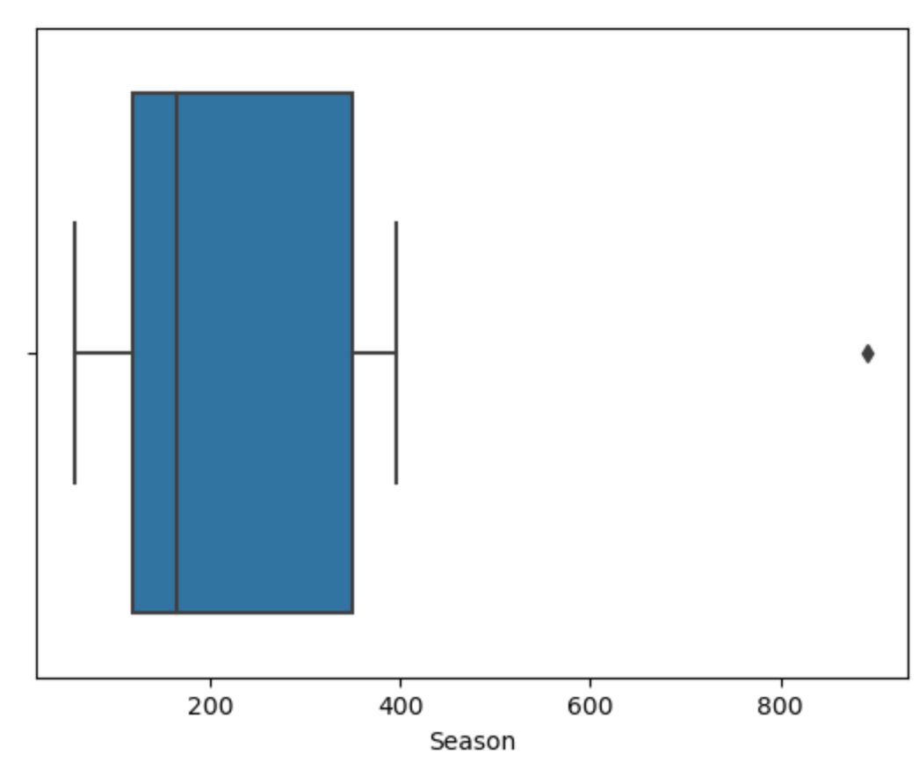
Deaths Per Season
Median: 164
Mean: 278

Slide 11
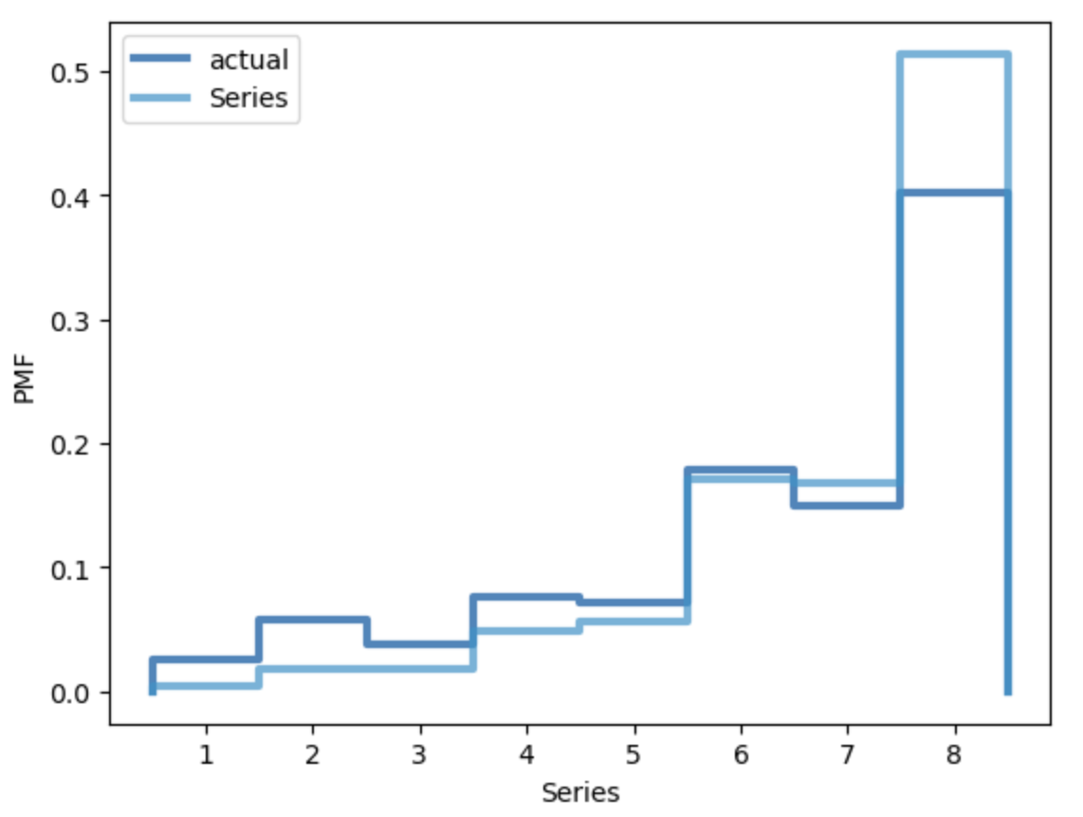
PMF of Deaths Over Series

Slide 12
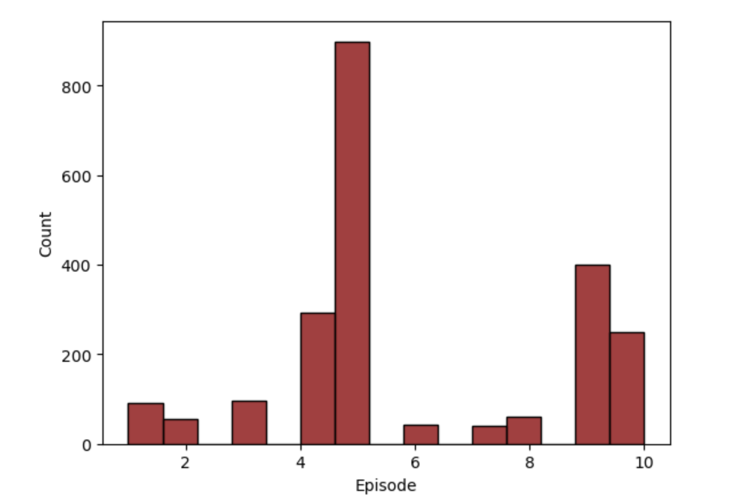
All Deaths By
Episode
The episode with the most deaths in any given season is 5 and 9. This was surprising as I would expect episode 10 to have the most deaths for impact, i.e. cliffhangers.

Slide 13
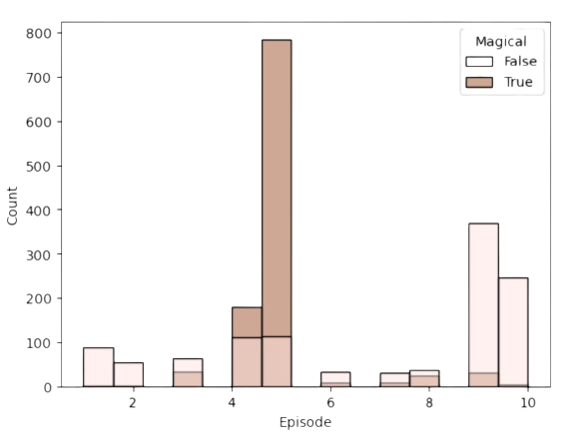
Magical deaths were almost exclusively episodes 4 and 5. Looking at how many are Magical made me think that there may be an outlier that is skewing this data

Slide 14
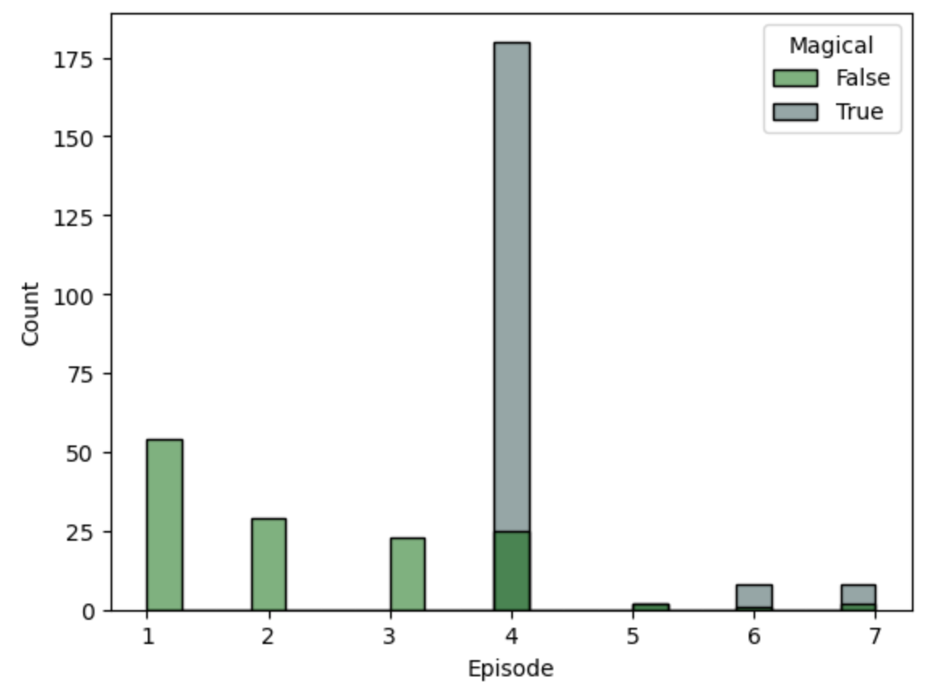
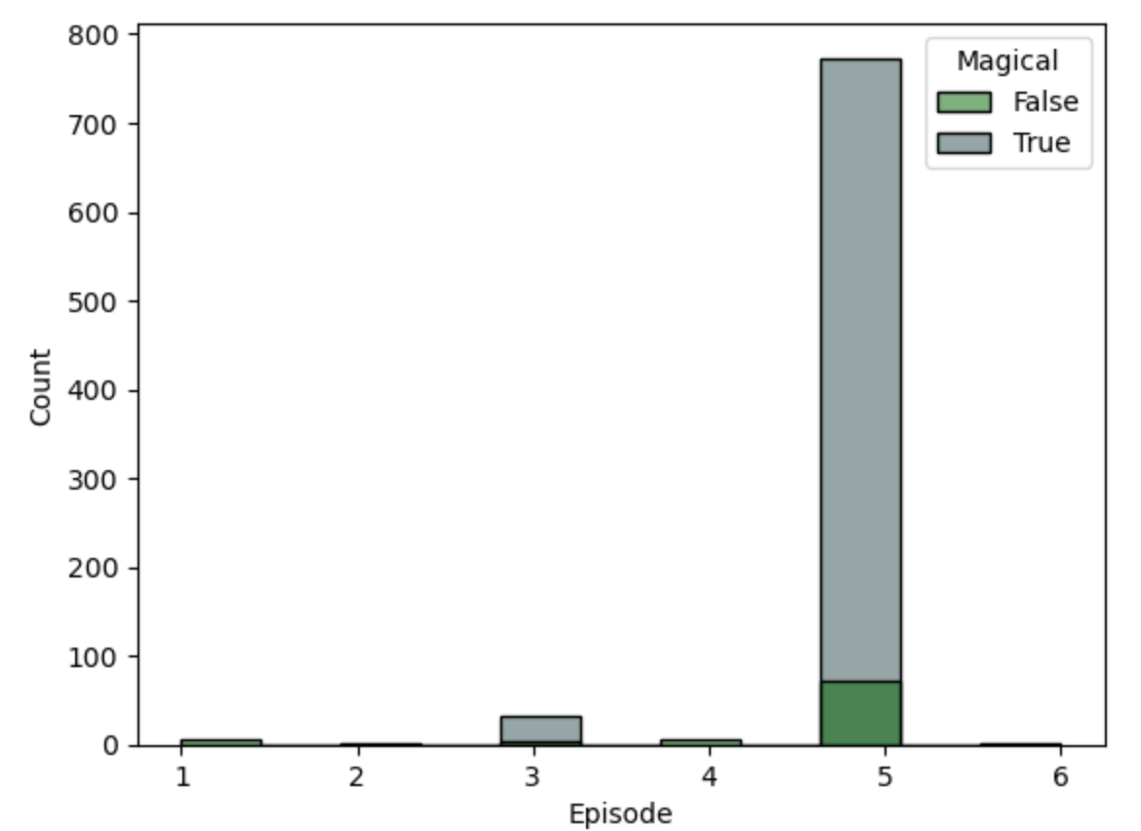
Season 7 episode 4 and season 8 episode 5 look like they could be considered outliers due to large magical battles
There are also fewer episodes in these seasons compared to other seasons

Slide 15
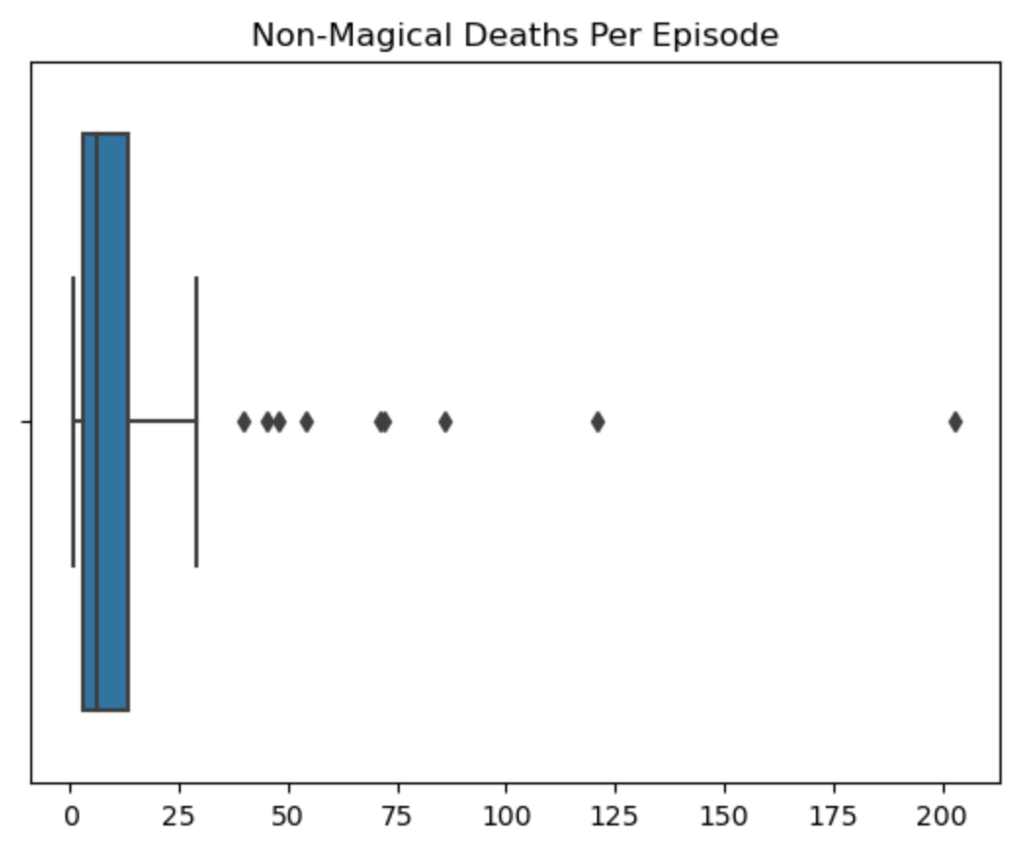
69 of 73 episodes have one or more deaths
The median of all deaths per episode is 7 and the mean is 32.
37.9% (844) of deaths take place during the final battle in season 8 episode 5 and about 50% across the series are magical.
When looking at non-magical deaths only, the median is similar at 6 deaths per episode, however, the mean has a dramatic change to 17 deaths per episode. There are 8 episodes that still have a significant increase in number of deaths than other episodes.

Slide 16
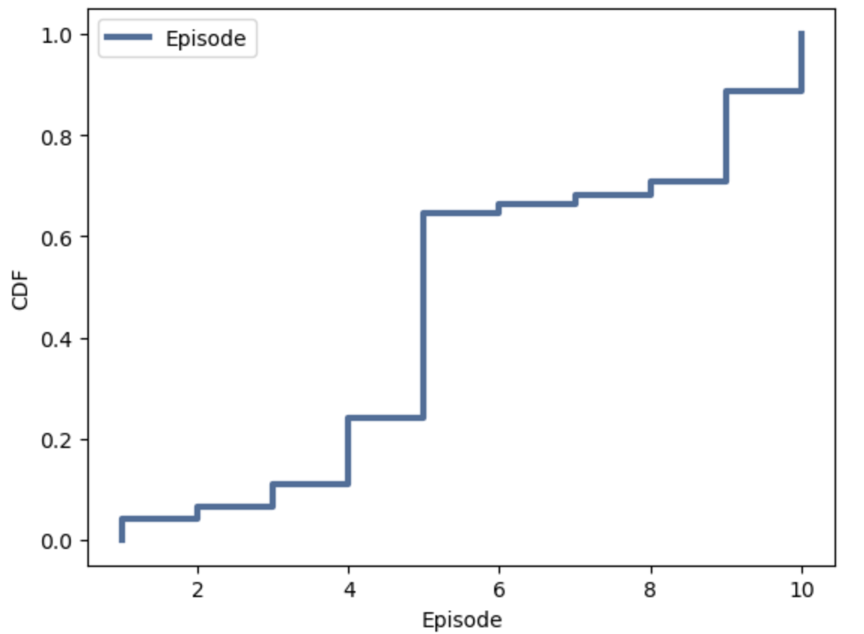
CMF by Episode indicates a higher probability later in the season, with a large shift at episode 5.

Slide 17
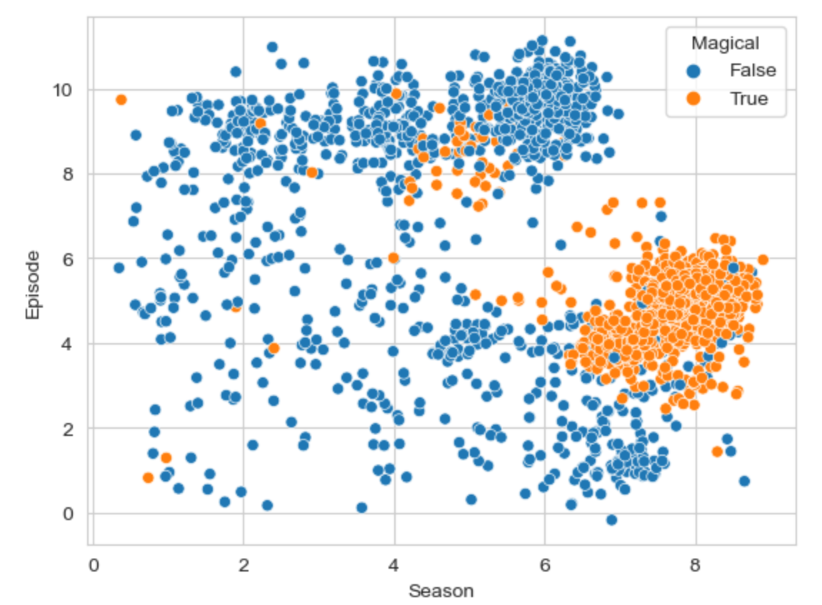
Scatterplot of Season VS Episode, Magical VS non-Magical
This plot shows that while there are deaths across all episodes of all season, there are higher concentrations towards the end of a season, with the highest concentrations in seasons 7 and 8. This also predicts that if there had been seasons 9 and 10 that had season durations like 7 and 8, that there would have been a high number of deaths in them as well. It also shows that the magical deaths were clustered towards the end of the series.

Slide 18
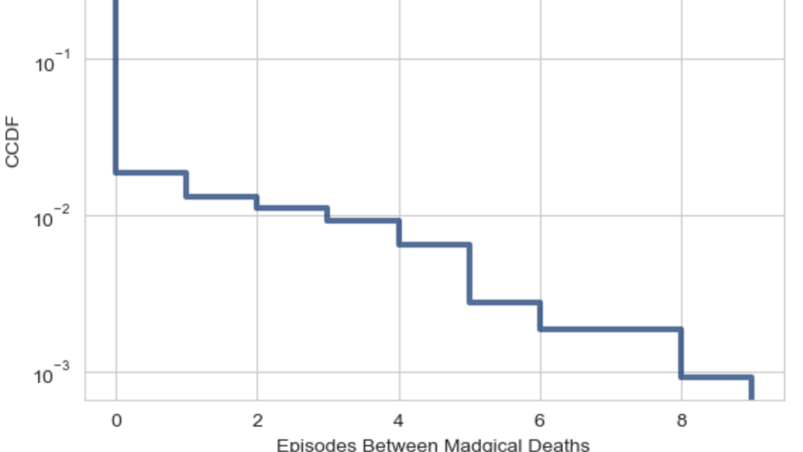
CCDF Episodes Between Magical Deaths
There is a downward trend showing that magical deaths get closer together as the series goes on.

Slide 19

Number of kills
Next, we will look at the number of kills by people and by weapon, and how many people/weapons had similar number of kills

Slide 20
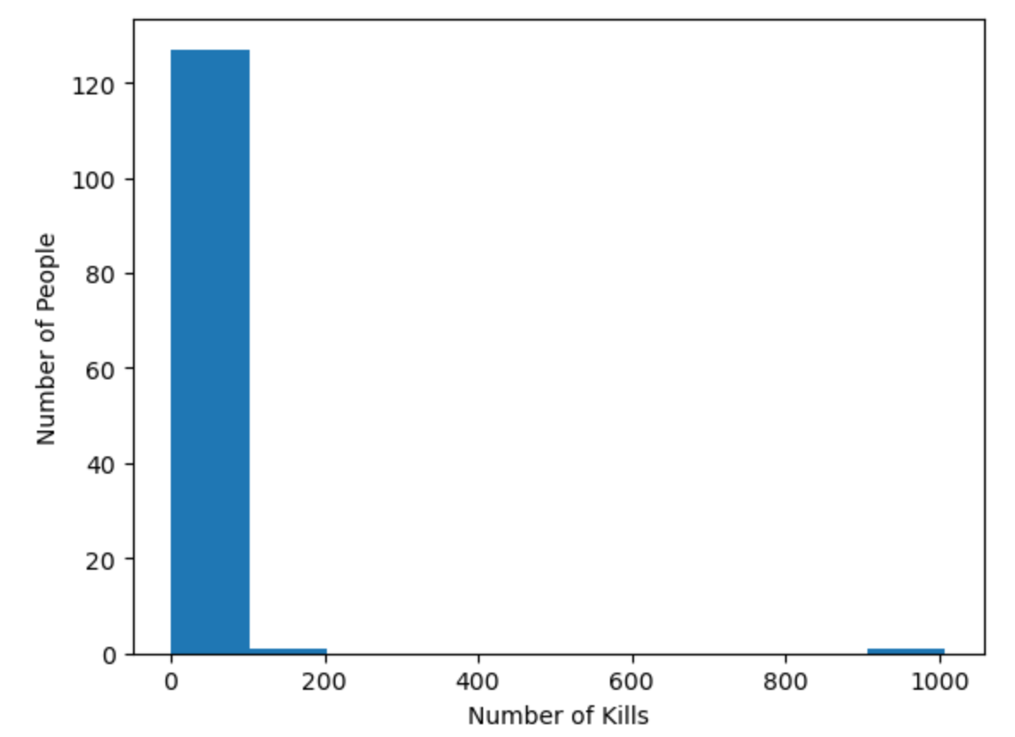
All Kills Counts by killer
There appears to be two outliers here since almost all of the kills are in the 1-100 range. Outliers would be those in the 100-200 range and 900-1000 range, which are each only one person: Cersei Lannister and Daenerys Targaryen, respectively.

Slide 21
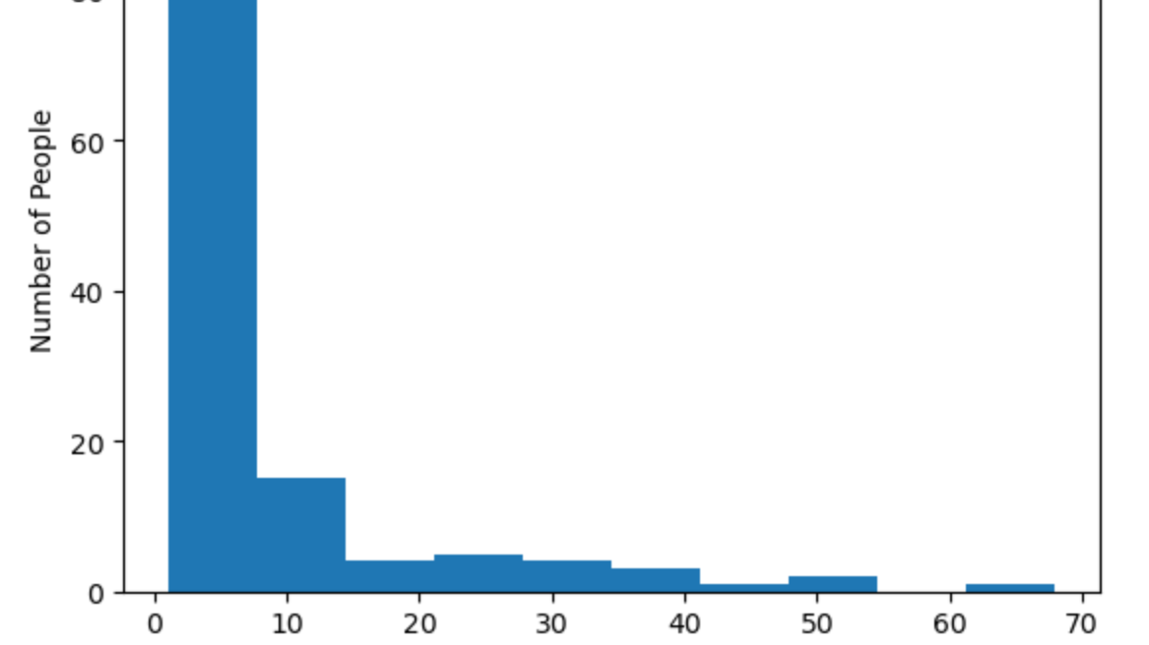
By removing the outliers we can see that most of the killers had fewer than 10 kills

Slide 22
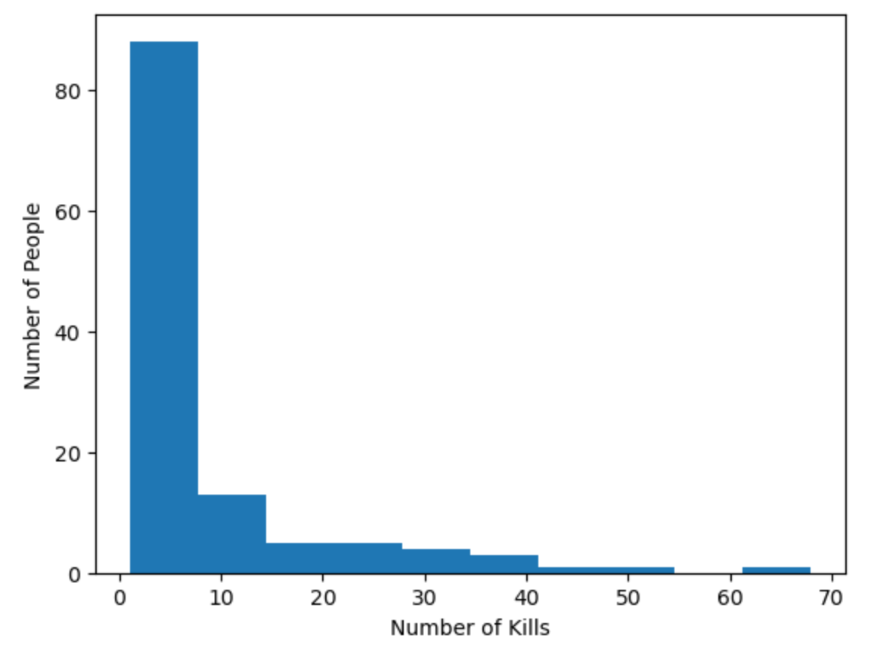
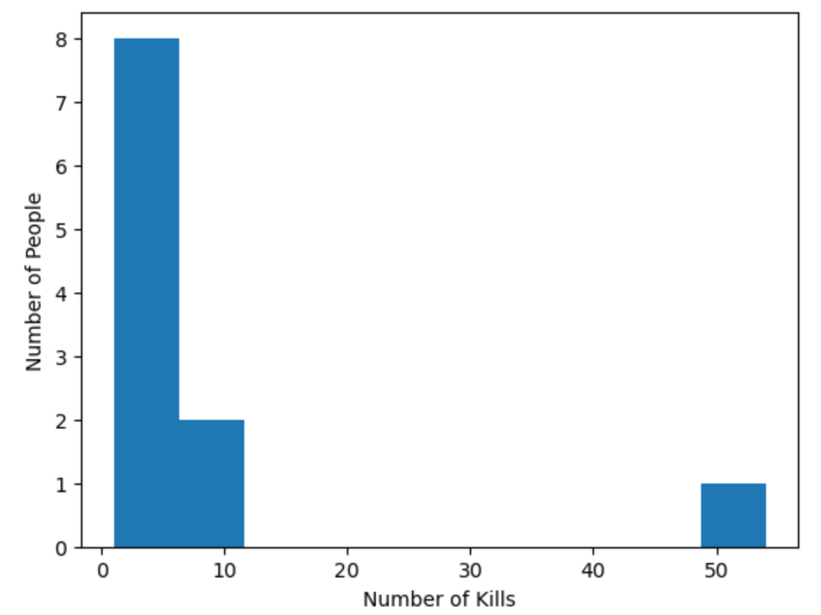
How Many Were Non-Magical VS Magical
Non-Magical
Magical
This comparison easily depicts that most of the killers had non-magical means of killing, with only 11 people having magical kills when excluding Daenerys Targaryen’s nearly thousand magical kills.

Slide 23
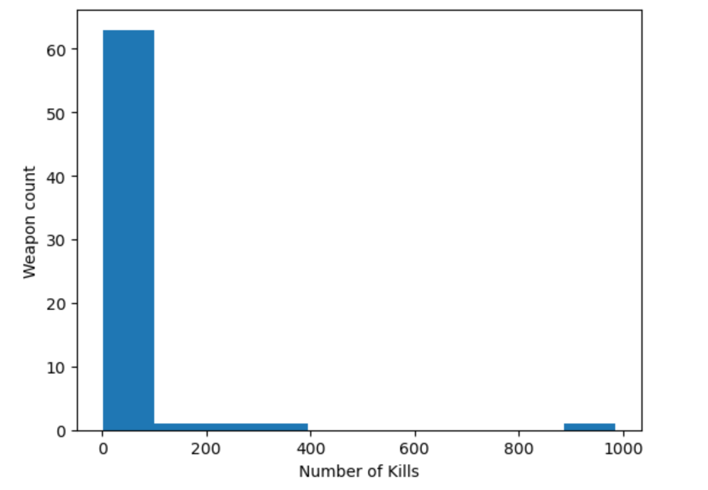
All kills count by weapon
Again, we are able to see some clear outliers here with the majority of the weapons having fewer than 100 deaths associated with them. Only the following have more than 100:
Dragonfire (986)
Sword (322)
Wildfire (210)
Knife (119)

Slide 24
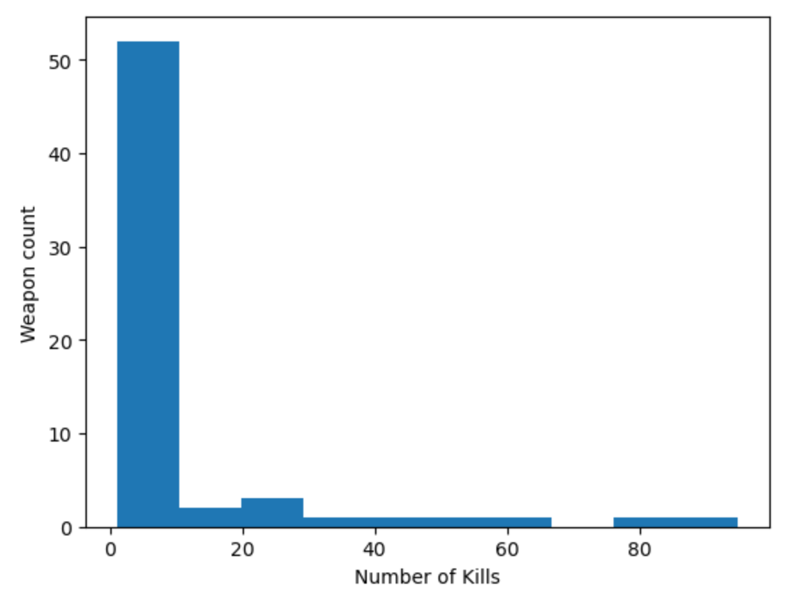
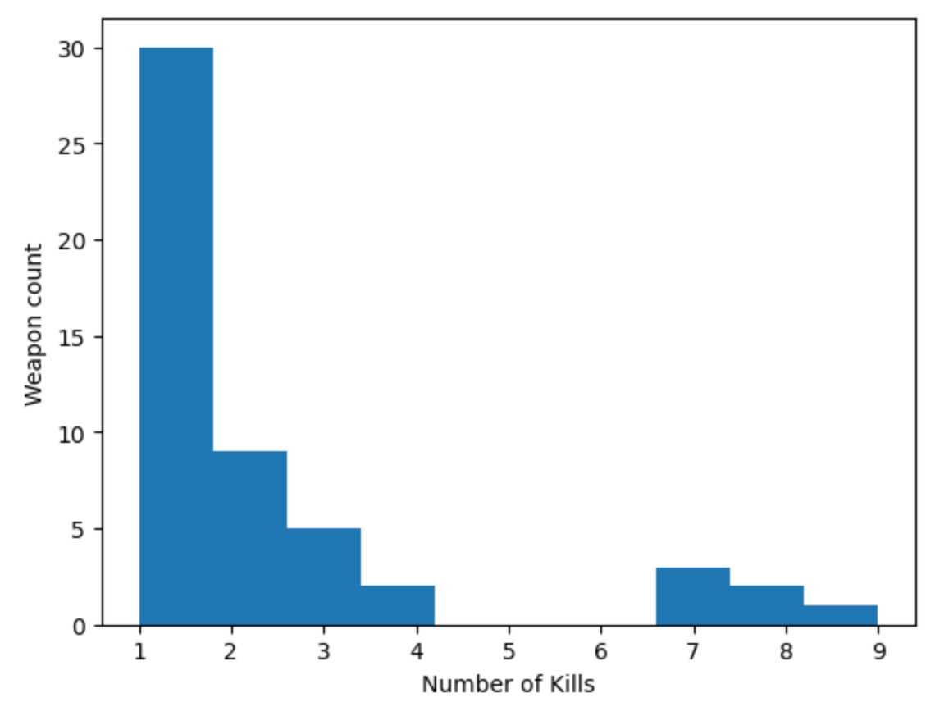
Removing Weapon Outliers
Looking at under 100 kills we can see that the majority have less than 10
narrowing even further we see that most weapons are only associated with one death

Slide 25
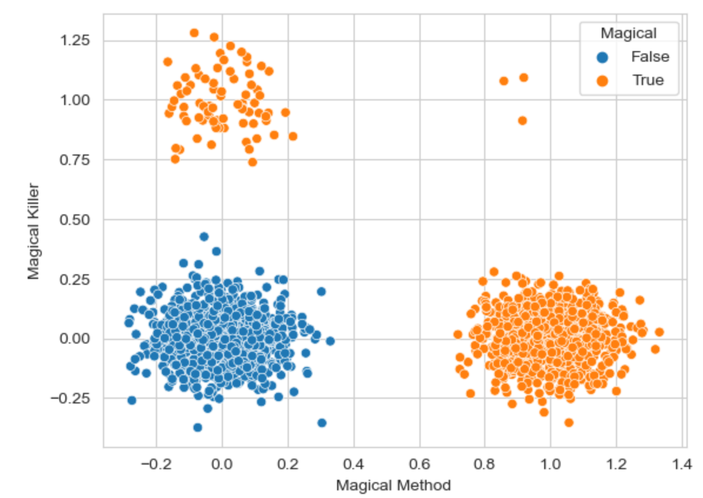
Magical Killer VS Magical Method
This plot shows that there is actually very little overlap where a magical killer used a magical method, and that there is more data to support a magical killer using a non-magical method or a non-magical killer (Daenerys specifically) using magical methods.

Slide 26

House association
How many houses had similar number of deaths by killers and victims

Slide 27
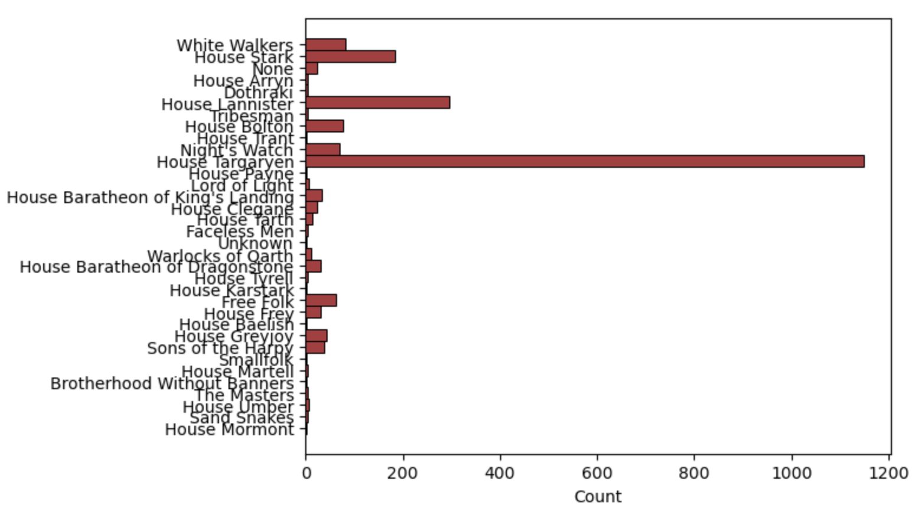
Killer’s House
Clearly House Targaryen is an outlier, again due to the nearly 1000 magical deaths she has to her name

Slide 28
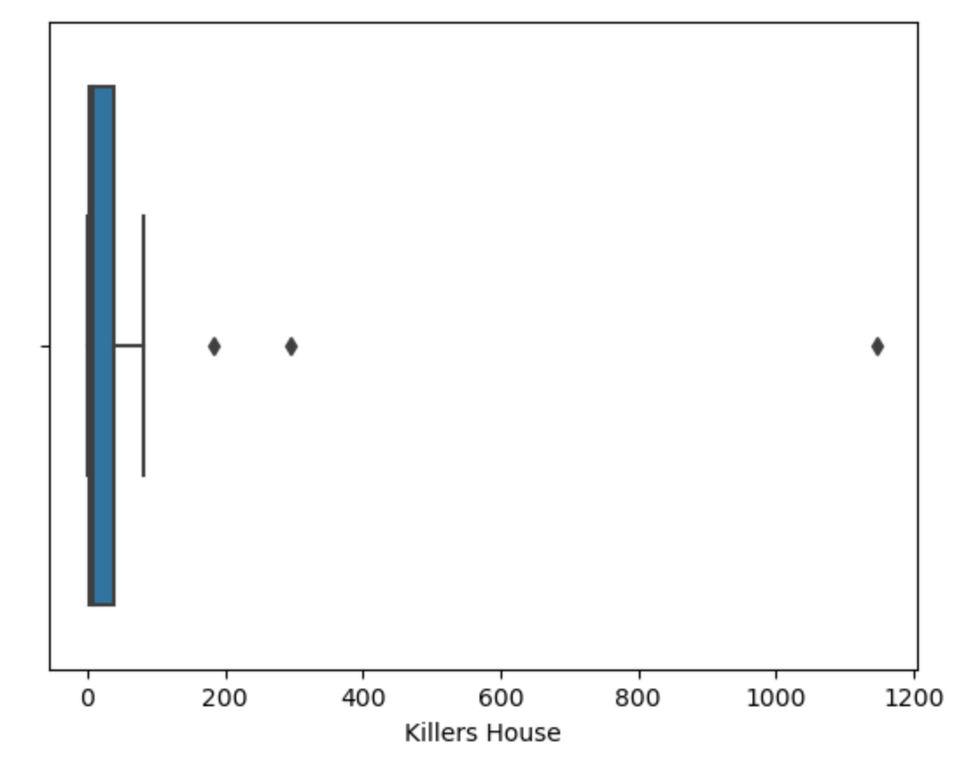
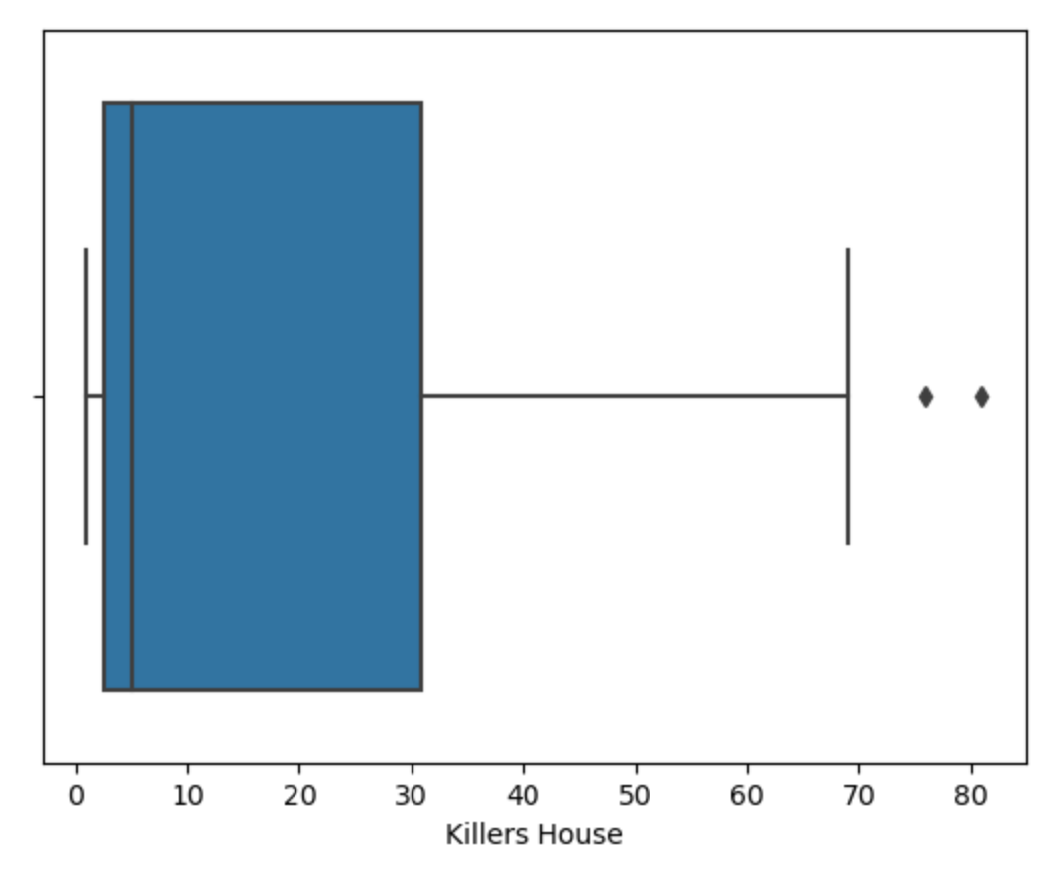
Median & Mean Killers per house
After running a box plot on all killer houses, the outliers were too far apart to read it effectively, however, after removing the top three outliers, it looks to be about 5 kills per killer’s house.
When running actual median calculations with get a median of 7 and a mean of 65.

Slide 29
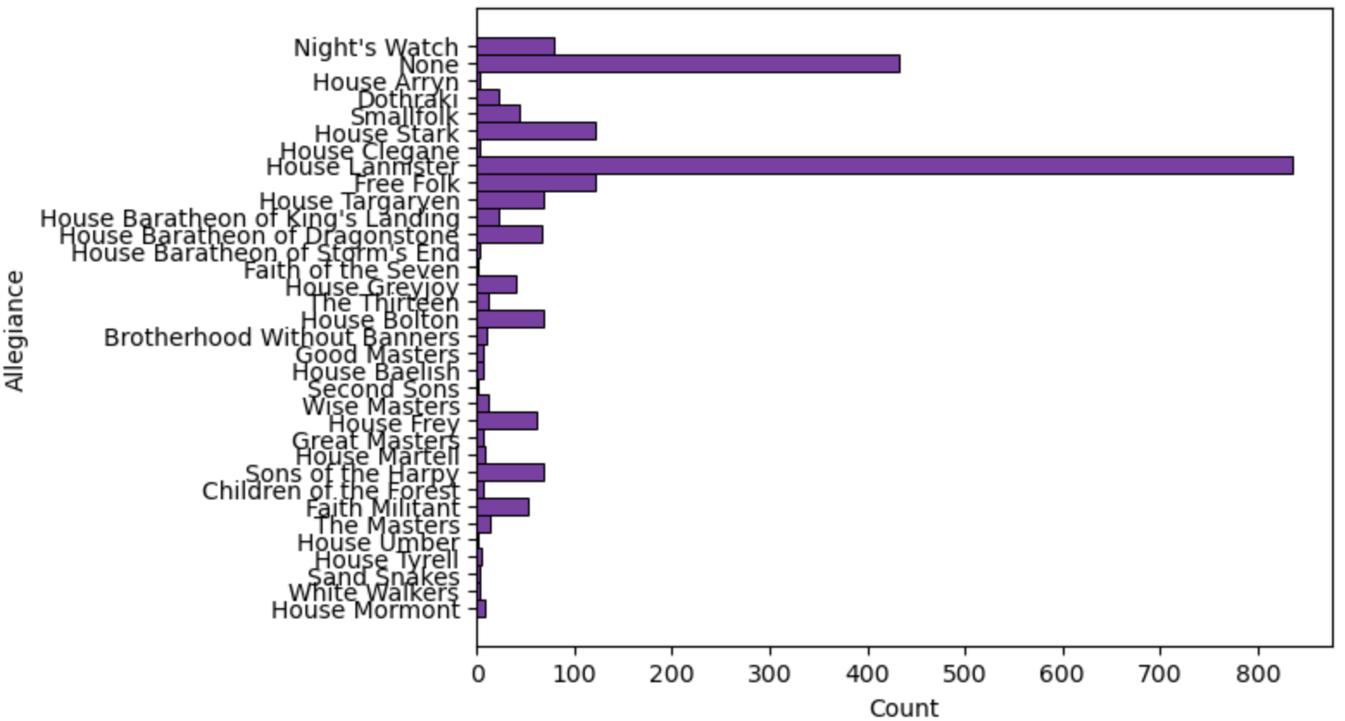
Victims’ Houses (houses with more than one death)
Potential outliers for victim allegiance is singletons, which were removed prior to creating the histogram. There are also a disproportionate amount of Lannisters that died, however, the most curious piece is the number of victims not associated with a house.

Slide 30
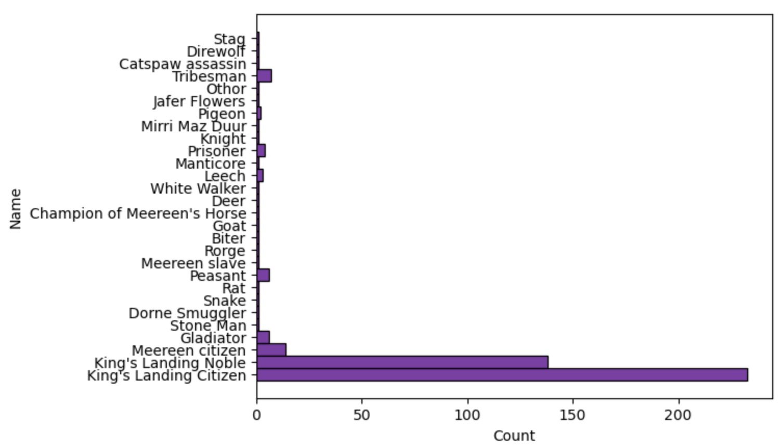
Victims with No House Alliance
When looking further into those who died with no house alliance, we see that there are animals and people without names with the largest numbers being labeled King’s Landing Citizens and Nobles.

Slide 31
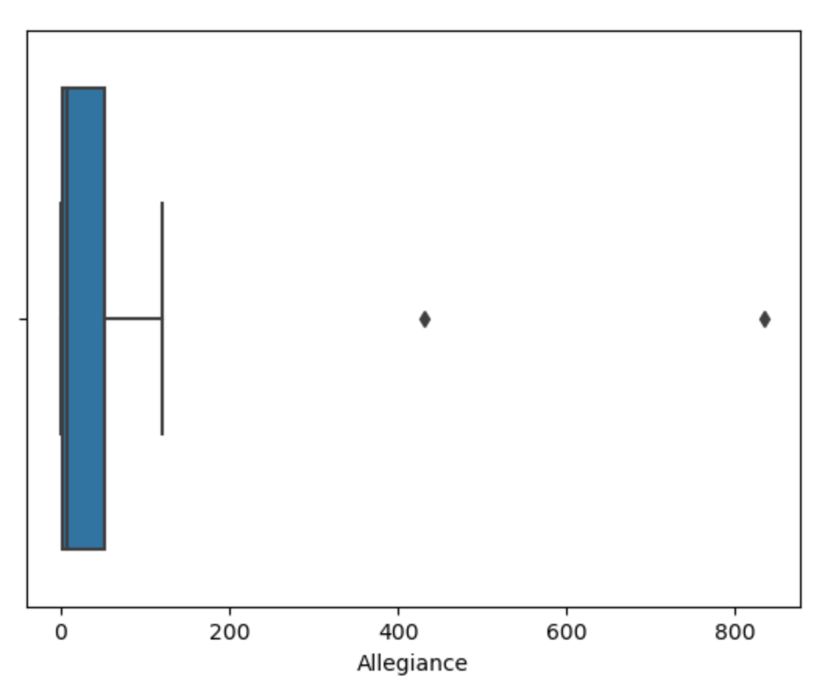
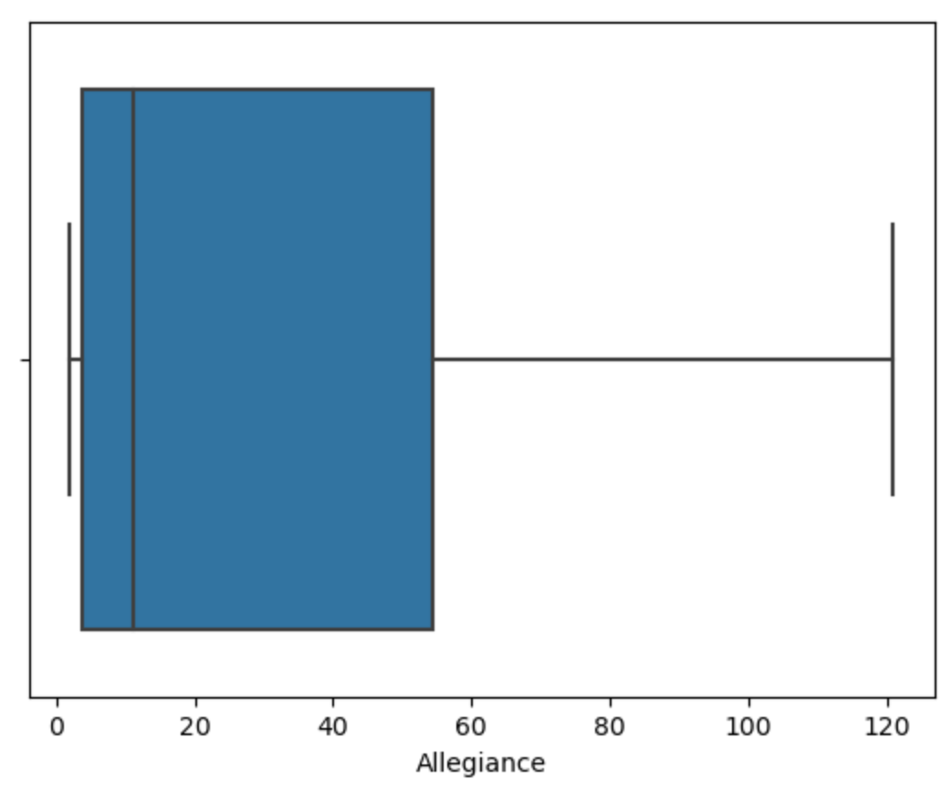
Median & Mean victims per house
After running a box plot on all victim allegiances, the outliers were too far apart to read it effectively, however, after removing the singletons, those with no allegiance, and House Lannister, we can see that remaining houses had a median around 10 victims.
When running actual median calculations with get a median of 8 including outliers and 11 excluding outliers. However, the Mean per house is 54 and 30 respectively.

Slide 32

Hypothesis Test: Non-Magical VS Magical
When running a hypothesis test regarding if a death will be non-magical or magical, I put in the actual number of deaths of each: 1149 and 1075, respectively. This produces a p-value of 12.2% With a p-value greater than 10%, the predictability is likely up to chance.

Slide 33

Hypothesis Test: Non-Magical VS Magical
Knowing that Cersei and Daenerys are both outliers for the number of deaths at their hands, I removed them and ran the hypothesis test again. This time there were 950 non-magical deaths and only 88 magical deaths. This model produced a p-value of 0, and thus giving statistical significance that a death is likely to be non-magical and there is little chance of a death being magical.

Slide 34

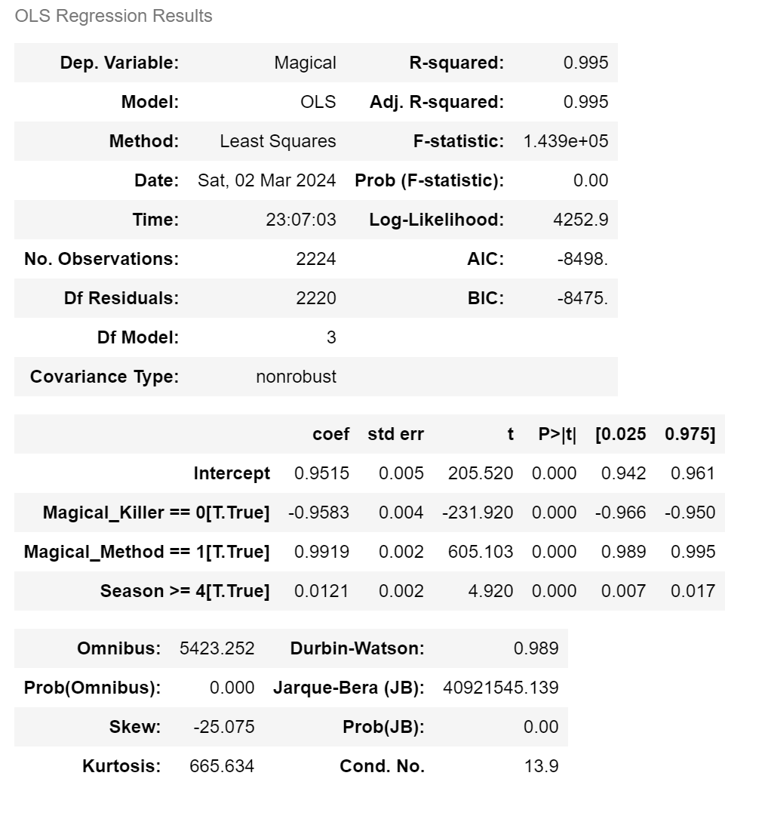
Regression Analysis

Slide 35

Conclusion
While my predictions were true, even those results were outliers to the remaining data. It was interesting to narrow the data and look at the numbers and statistics of the deaths that weren’t statistically disproportional to the others.

